Slide 1
TurboCRNN: A Robust and Efficient Architecture for Wake Word Detection
Guide: Dr. Mohanaprasad K Project ID: PC41
f Tejeswar A Ramachandran 19BEC1439
Dhairya Lalwani 19BEC1326

Slide 2
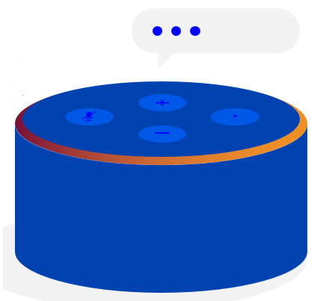
INTRODUCTION
Wake word detection is the task of recognizing the utterance of a keyword for activating a voice assistant.
Our research aims on creating a novel wake word detection model with efficient input preprocessing and an optimized neural network architecture for accurate detection of wake word from a given audio input.

Slide 3

MOTIVATION
Speech is a natural human ability that doesn't require special training, enhances multitasking by freeing up the hands and eyes, and is faster and more effective at transmitting information than traditional input techniques.
The industry standard for intelligent home automation systems and smart systems is a speech-to-intent conversion module to ease user-friendliness and enhance value. The word (spoken or conveyed as text) used to wake up or start computation in a smart system is defined as a wake word. Once the wake word is detected, the other sub-modules of the smart system are activated and available for use.
Even though the research in technologies surrounding wake word detection has been immense, a novel gap exists in the possibility of reducing false positives and creating a more lightweight model capable of running efficiently and directly on a low-power system such as a mobile. Existing technologies use the cloud to process the same.

Slide 4
PROBLEM STATEMENT
To build a optimized novel Wake Word Detection model with minimal false predictions, reduced latency, and low complexity.

Slide 5
THE DATASET
Dataset Used: Google Speech Commands Dataset
Dataset Details:
30 Words in total
65000 Audio Samples in total
.wav Format
Almost 1 second in duration
Wake Word chosen for our Research: Marvin
To ensure balanced data distribution, 61 samples were chosen at random, using a python script, from each of the remaining 29 words to create the dataset for false samples.
Dataset Size: Marvin - 1746 Samples
False Data - 1769 Samples

Slide 6
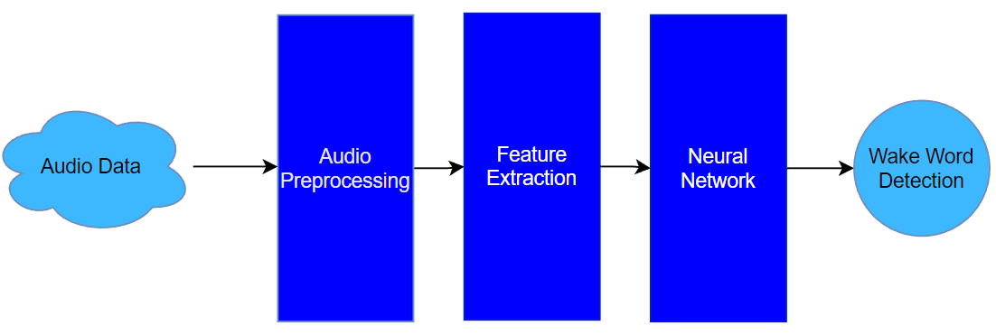
WAKE WORD DETECTION

Slide 7
AUDIO PREPROCESSING

Slide 8

DENOISING
Wavelet Decomposition - Using the db4 wavelets from the Daubechies Family.
The Signal is broken down into separate frequency bands.
Thresholding is performed to redact noise from the audio sample.
The denoised audio sample is reconstructed by performing inverse wavelet transform

Slide 9
DATA AUGMENTATION
DATA AUGMENTATION TECHNIQUES IMPLEMENTED:
Time Scaling
Pitch Scaling
White Noise Addition
Polarity Inversion
Random Gain
 | Before Data Augmentation | After Data Augmentation
True Samples | 1746 | 10476
False Samples | 1769 | 10614
TOTAL SAMPLES AFTER AUGMENTATION 21090

Slide 10
FEATURE EXTRACTION

Slide 11
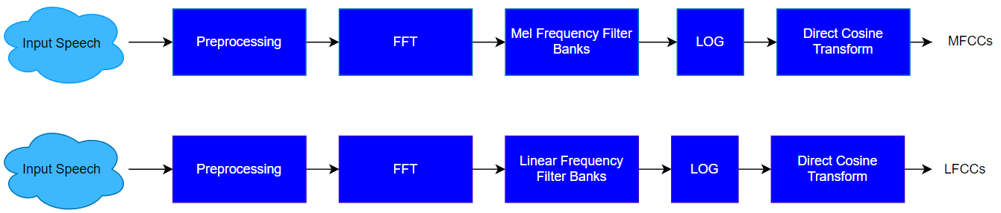
FEATURE EXTRACTION
Mel Frequency Cepstral Coefficients (MFCCs) are the most commonly used feature extraction technique in speech recognition.
In this research, we compare the performances of MFCCs with Linear Frequency Cepstral Coefficients (LFCCs), by training the baseline and proposed models on both the features.

Slide 12
LFCCs VS MFCCs
Proposed Model | MFCC | LFCC
DNN | 0.7141 | 0.8113
CNN | 0.9374 | 0.9317
LSTM | 0.9075 | 0.9692
GRU | 0.9431 | 0.9787
CRNN_GRU_LSTM | 0.9493 | 0.9815
CRNN_GRU_GRU | 0.9663 | 0.982

Slide 13
NEURAL NETWORKS

Slide 14
BASELINE & PROPOSED MODELS
Baseline Model Architectures: DNN, CNN, LSTM, GRU
Proposed Model Architectures:
CRNN_GRU_GRU - Convolutional Layers + GRU Layer + GRU Layer
CRNN_GRU_LSTM - Convolutional Layers + GRU Layer + LSTM Layer
Experimentation on the Proposed Model Architectures: Multi-head Attention, L2 Regularizer, An Extra Dense Layer
Optimizer, Loss Functions, Train-Test Split: AMS Grad Optimizer, Categorical Cross Entropy Split Ratio: 80% Training, 10% Validation, 10% Testing
120 Epochs, Learning Rate = 0.01

Slide 15
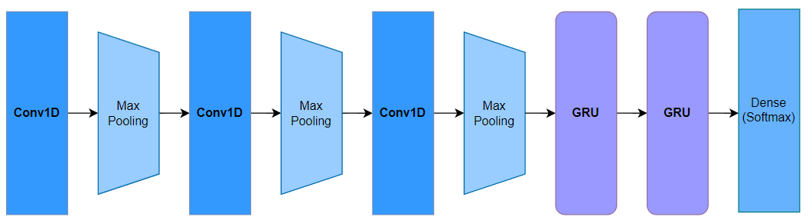
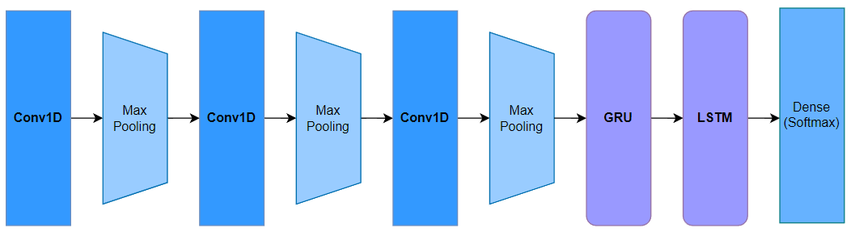
CRNN MODEL ARCHITECTURES
CRNN_GRU_GRU Model Architecture
CRNN_GRU_LSTMModel Architecture

Slide 16
COMPARISON WITH BASELINES
Models | Accuracy | False Positives | False Negatives
DNN | 0.8113 | 338 | 60
CNN | 0.9317 | 73 | 71
LSTM | 0.9692 | 47 | 18
GRU | 0.9787 | 25 | 20
CRNN_GRU_LSTM | 0.9815 | 18 | 21
CRNN_GRU_GRU | 0.982 | 18 | 20

Slide 17
CRNN_GRU_GRU MODEL VARIANTS
# | Proposed CRNN_GRU_GRU Variants | Accuracy | False Positives (FP) | False Negatives (FN) | False Predictions (FP + FN) | Reduction in False Predictions (%)
1 | Without Extra Dense layer, Without Attention | 0.982 | 18 | 20 | 38 | Baseline
2 | Without Extra Dense layer, With Attention | 0.9844 | 19 | 14 | 33 | 13.157
3 | Without Attention, With Regularizer | 0.9815 | 21 | 18 | 39 | -2.631
4 | With Attention, With Regularizer | 0.981 | 19 | 21 | 40 | -5.2631
5 | With Extra Dense layer, Without Attention | 0.9725 | 17 | 41 | 58 | -52.631
6 | With Extra Dense layer, With Attention | 0.9825 | 25 | 12 | 37 | 2.631
7 | With Extra Dense layer, With Regularizer | 0.9791 | 25 | 19 | 44 | -15.789
8 | With Extra Dense, With Regularizer, With Attention | 0.9806 | 22 | 19 | 41 | -7.894

Slide 18
CRNN_GRU_LSTM MODEL VARIANTS
# | Proposed CRNN_GRU_LSTM Variants | Accuracy | False Positives (FP) | False Negatives (FN) | False Predictions (FP + FN) | Reduction in False Predictions (%)
1 | Without attention, without extra Dense layer | 0.9815 | 18 | 21 | 39 | Baseline
2 | With attention, without extra Dense layer | 0.9829 | 17 | 19 | 36 | 7.692
3 | Without attention, with regularizer | 0.981 | 22 | 18 | 40 | -2.564
4 | With attention, with regularizer | 0.9768 | 30 | 19 | 49 | -25.641
5 | With an Extra Dense layer, without Attention | 0.9853 | 19 | 12 | 31 | 20.512
6 | With an Extra Dense layer, with Attention | 0.981 | 21 | 19 | 40 | -2.564
7 | With an Extra Dense layer, With Regularizer | 0.9791 | 27 | 17 | 44 | -12.82
8 | With an Extra Dense layer, with Regularizer, with Attention | 0.9829 | 18 | 18 | 36 | 7.692

Slide 19
250K PARAMETER BUDGET
Proposed Models & TinyCRNN Model | Accuracy | Parameters | False Predictions |  |  | Reduction in False Predictions (%)
 |  |  | False Positives (FP) | False Negatives (FN) | FP + FN | With respect to CNN Baseline | With respect to DNN Baseline
CRNN_GRU_LSTM #5 | 0.9853 | 220770 | 19 | 12 | 31 | 77.536 | 92.211
CRNN_GRU_LSTM #2 | 0.9829 | 332034 | 17 | 19 | 36 | 73.913 | 90.954
CRNN_GRU_LSTM #8 | 0.9829 | 335970 | 18 | 18 | 36 | 73.913 | 90.954
CRNN_GRU_GRU #2 | 0.9844 | 249986 | 19 | 14 | 33 | 76.086 | 91.708
CRNN_GRU_GRU #6 | 0.9825 | 303458 | 25 | 12 | 37 | 73.188 | 90.703
TinyCRNN (MO Khursheed et. al.) | 0.9782 | 247218 | 25 | 21 | 46 | 66.667 | 88.442

Slide 20
100K PARAMETER BUDGET
Proposed Models & TinyCRNN Model | Accuracy | Parameters | False Predictions |  |  | Reduction in False Predictions (%)
 |  |  | False Positives (FP) | False Negatives (FN) | FP + FN | With respect to CNN Baseline | With respect to DNN Baseline
CRNN_GRU_LSTM #5 (TurboCRNN) | 0.9839 | 87330 | 19 | 15 | 34 | 75.362 | 91.457
CRNN_GRU_LSTM #2 | 0.9825 | 102834 | 21 | 16 | 37 | 73.188 | 90.703
CRNN_GRU_LSTM #8 | 0.9815 | 161538 | 22 | 17 | 39 | 71.739 | 90.201
CRNN_GRU_GRU #2 | 0.9839 | 134242 | 15 | 19 | 34 | 75.362 | 91.457
CRNN_GRU_GRU #6 | 0.9829 | 125698 | 19 | 17 | 36 | 73.913 | 90.954
TinyCRNN | 0.9758 | 137362 | 24 | 27 | 51 | 63.043 | 87.185

Slide 21
LATENCY ANALYSIS | Latency (in ms) - 250k |  | Latency (in ms) - 100k
 | Parameter budget model |  | Parameter budget model
 | With GPU | Without GPU | With GPU | Without GPU
DNN with Attention (Baseline) | 66.04 | 79.61 | 66.04 | 79.61
CNN with Attention (Baseline) | 76.32 | 91.63 | 76.32 | 91.63
LSTM with Attention (Baseline) | 76.21 | 93.03 | 76.21 | 93.03
GRU with Attention (Baseline) | 73.51 | 104.19 | 73.51 | 104.19
CRNN_GRU_LSTM #2 (Proposed) | 74.99 | 66.86 | 70.6 | 70.82
CRNN_GRU_LSTM #5 (Proposed) | 75.4 | 70.77 | 73.9 | 80.57
CRNN_GRU_LSTM #8 (Proposed) | 75.31 | 87.57 | 75.68 | 73.82
CRNN_GRU_GRU #2 (Proposed) | 74.55 | 63.45 | 73.24 | 69.99
CRNN_GRU_GRU #6 (Proposed) | 75.95 | 65.75 | 71.11 | 93.31
Tiny CRNN (MO Khursheed et. al.) | 72.91 | 125.49 | 72.02 | 95.36

Slide 22
CONCLUSIONS
We propose a Novel TurboCRNN architecture for wake word detection.
Trained on Linear Frequency Cepstral Coefficients (LFCCs), obtained from audio data denoised using Wavelet Decomposition.
Best Performer in the 100k Parameter budget: CRNN_GRU_LSTM Model Variant #5 - With Extra Dense Layer, Without Attention, Without Regularizer - TurboCRNN
75% and 91% reduction in false predictions when compared to CNN and DNN baselines.
74ms and 80ms latencies in the presence and absence of GPU.
87k model parameters, low model complexity.

Slide 23
REFERENCES
M. O. Khursheed, C. Jose, R. Kumar, G. Fu, B. Kulis and S. K. Cheekatmalla,
"Tiny-CRNN: Streaming Wakeword Detection in a Low Footprint Setting", 2021 IEEE Automatic Speech Recognition and Understanding Workshop (ASRU), 2021, pp. 541-547, doi: 10.1109/ASRU51503.2021.9688299.
2. Wei, Y., Gong, Z., Yang, S. et al. “EdgeCRNN: an edge-computing oriented model of acoustic feature enhancement for keyword spotting”. J Ambient Intell Human Comput 13, 1525–1535 (2021). https://doi.org/10.1007/s12652-021-03022-1.
3. Christin Jose, Yuriy Mishchenko, Thibaud Senechal, Anish Shah, Alex Escott, Shiv Vitaladevuni et al. “Accurate Detection of Wakeword Start and End Using a CNN”. INTERSPEECH 2020, Amazon Science, https://doi.org/10.48550/arXiv.2008.03790.

Slide 24

THANK YOU

